Slide 1
Java Project
BANKING SYSTEM
Made by : Rijul Kundan

Slide 2
PROBLEM STATEMENT
Create a bank project where we can store the bank customer details
Deposit the money.
Withdraw money.
Check the balance.
And display the final balance.
Display the list of customers of the bank with the final balance.
Minimum balance should be 1000.

Slide 3
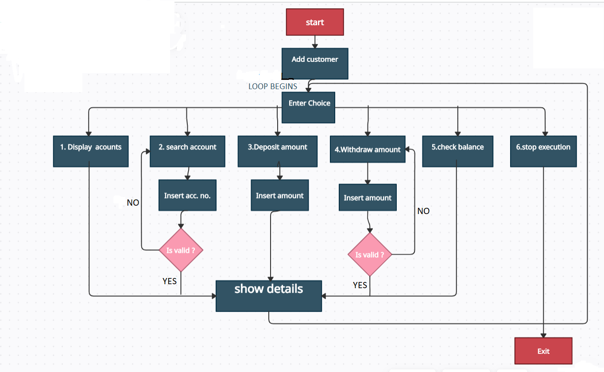
FLOW CHART

Slide 4
ACTIVITY DIAGRAM

Slide 5
SOLUTION DEMO
Github repo link:

Slide 6
THANK YOU !

